Slide 1
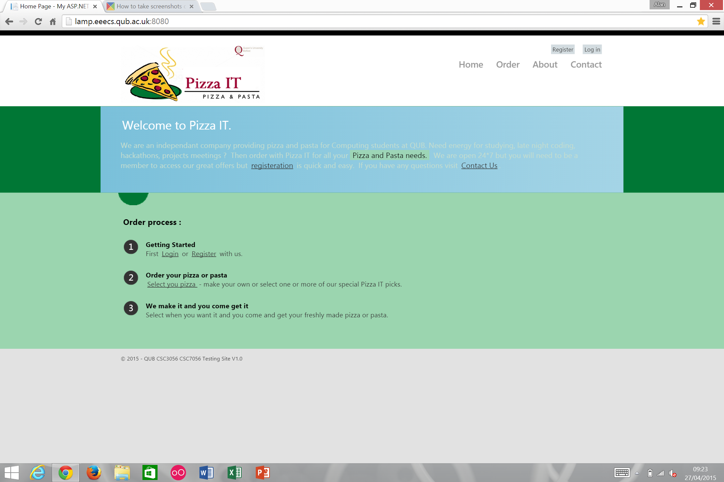
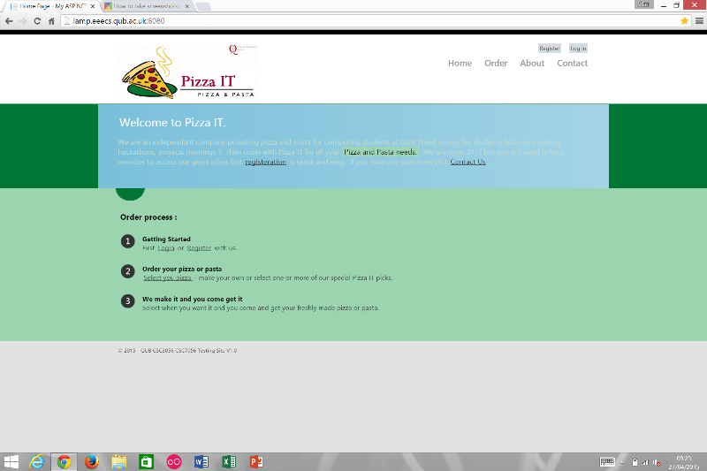
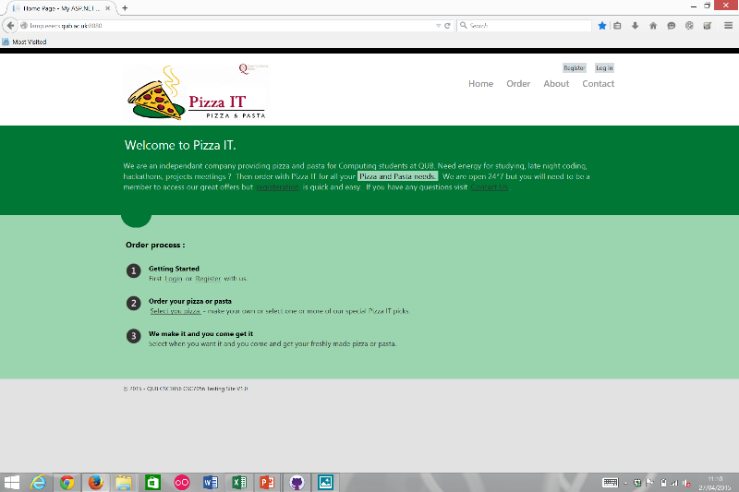
Home Page
2 Cosmetic and 2 Minor defects found.
Some spelling mistakes and a formatting error.
Problem with the Select your Pizza link.

